Slide 1

Presented By:- Presented To:- Jasleen Kaur(201500312) Mr. Akash Kumar Choudhary (Technical Trainer)
Full Stack Project
On
EVERYDAY STORY

Slide 2

What IS Blogging WEBSITE?
A blog, short for weblog, is a frequently updated web page used for personal commentary or business content. Blogs are often interactive and include sections at the bottom of individual blog posts where readers can leave comments.

Slide 3

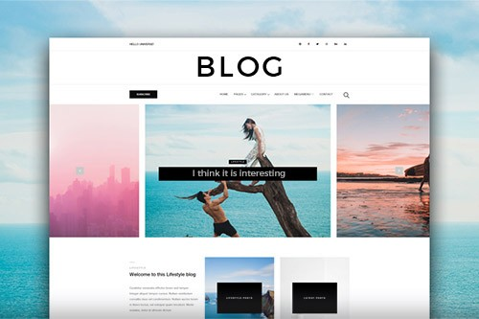
INTRODUCTION
A blog (short for “weblog”) is an online journal or informational website run by an individual, group, or corporation that offers regularly updated content (blog post) about a topic. It presents information in reverse chronological order and it is written in an informal or conversational style.

Slide 4
PURPOSE
The purpose is to perform each activity in computerized way which is time consuming.
To establish a constant flow of writing.
Less work for the front office.
Logical and effective journey.

Slide 5
Existing Features
“ EVERYDAY STORY’’ has been designed to computerize the following functions that are performed by the system :
Blog Designing and Writing Functions.
Check-in and check-out Functions.
Blog Interest of the User.
Statement of Customer Details.
Blog Interest Details.

Slide 6
Software Requirements
System Development software:-
Operating system : Windows
VS Code
React
MongoDB
User required software:-
Operating System : Windows 7,8,10
GitHub

Slide 7
HARDWARE REQUIREMENTS
System Development hardware:-
CPU : AMD Ryzen 5 , 4.0GHz
RAM : 8GB
Monitor : Color monitor

Slide 8
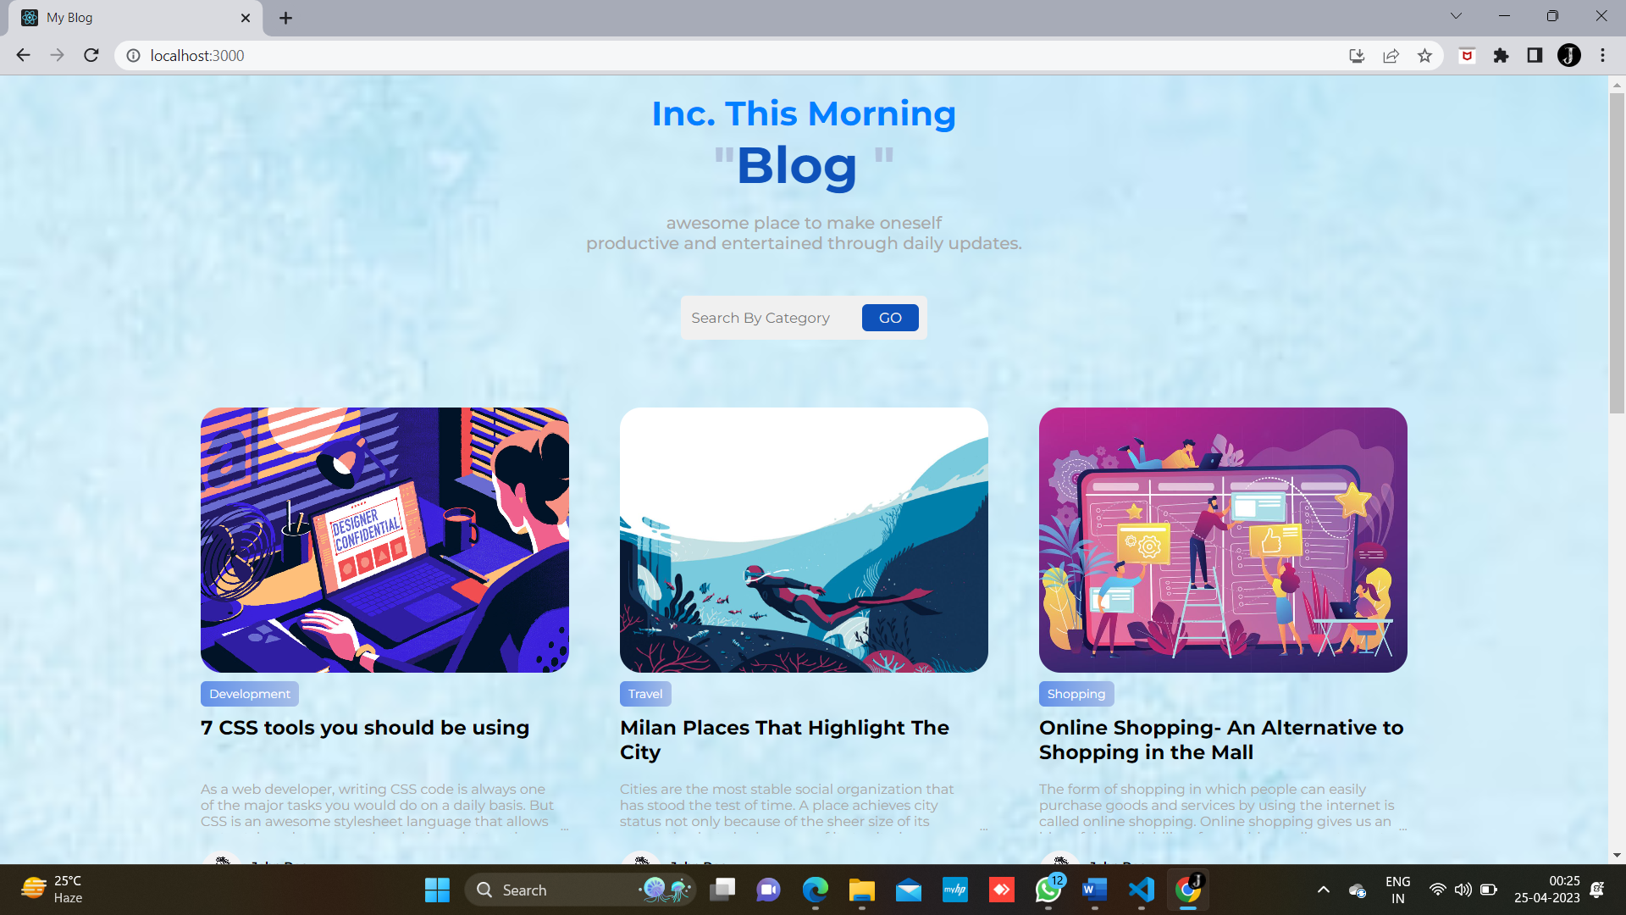
FRONTEND of EVERYDAY STORY

Slide 9
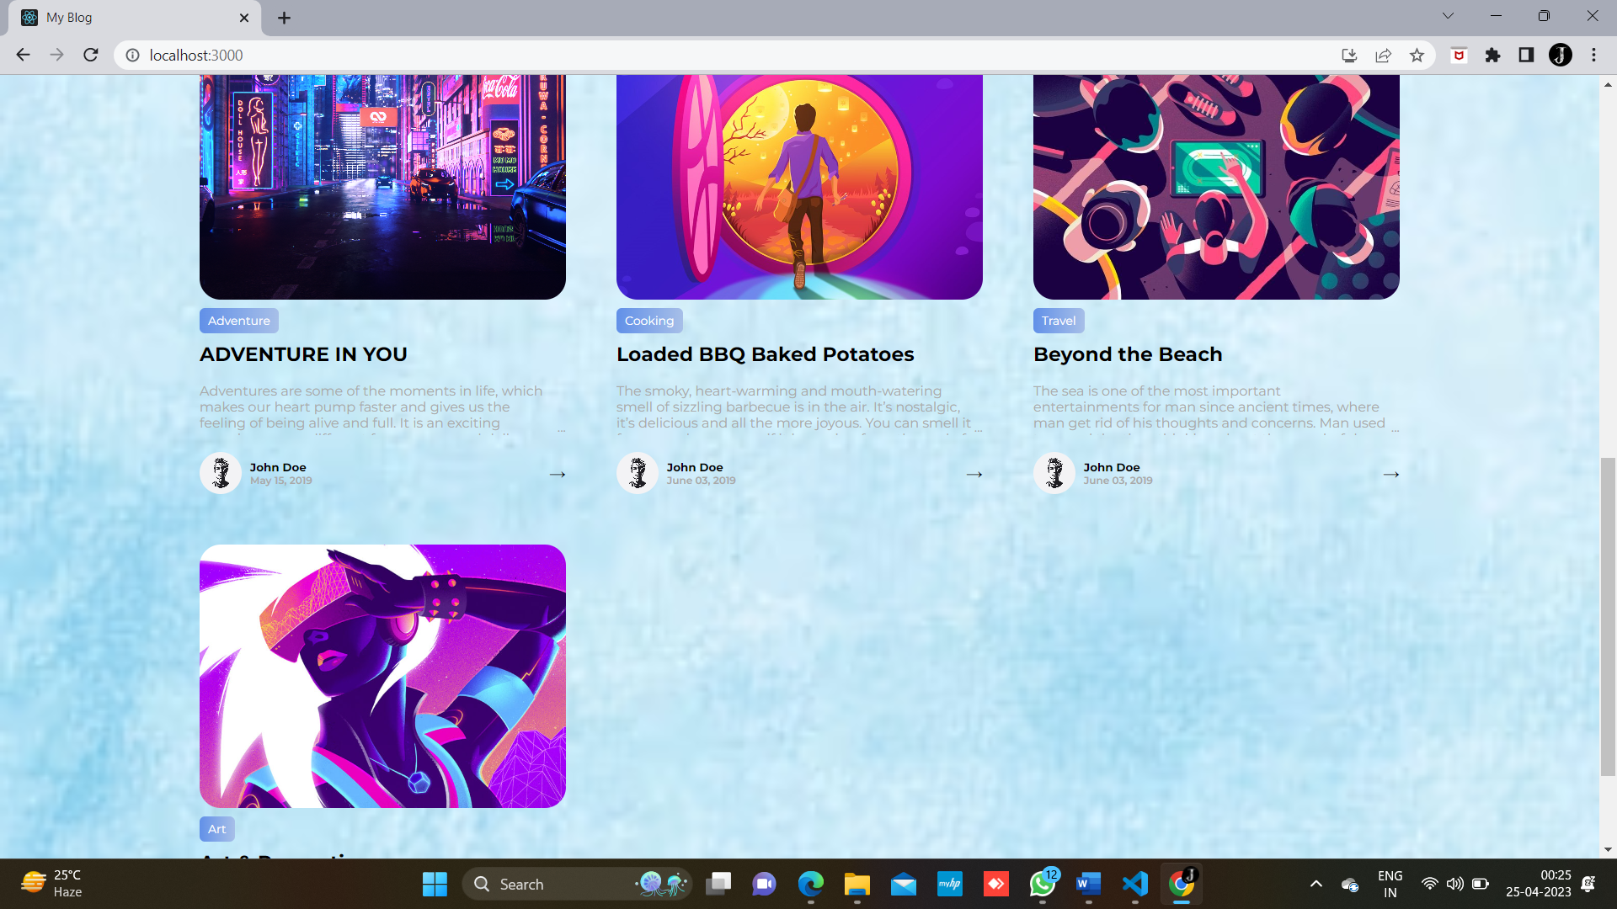
FOOTER page

Slide 10
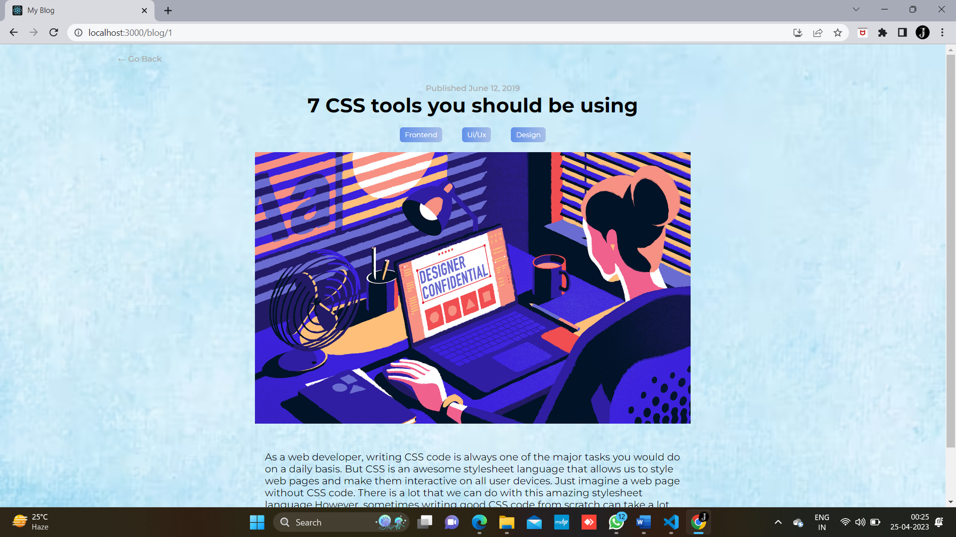
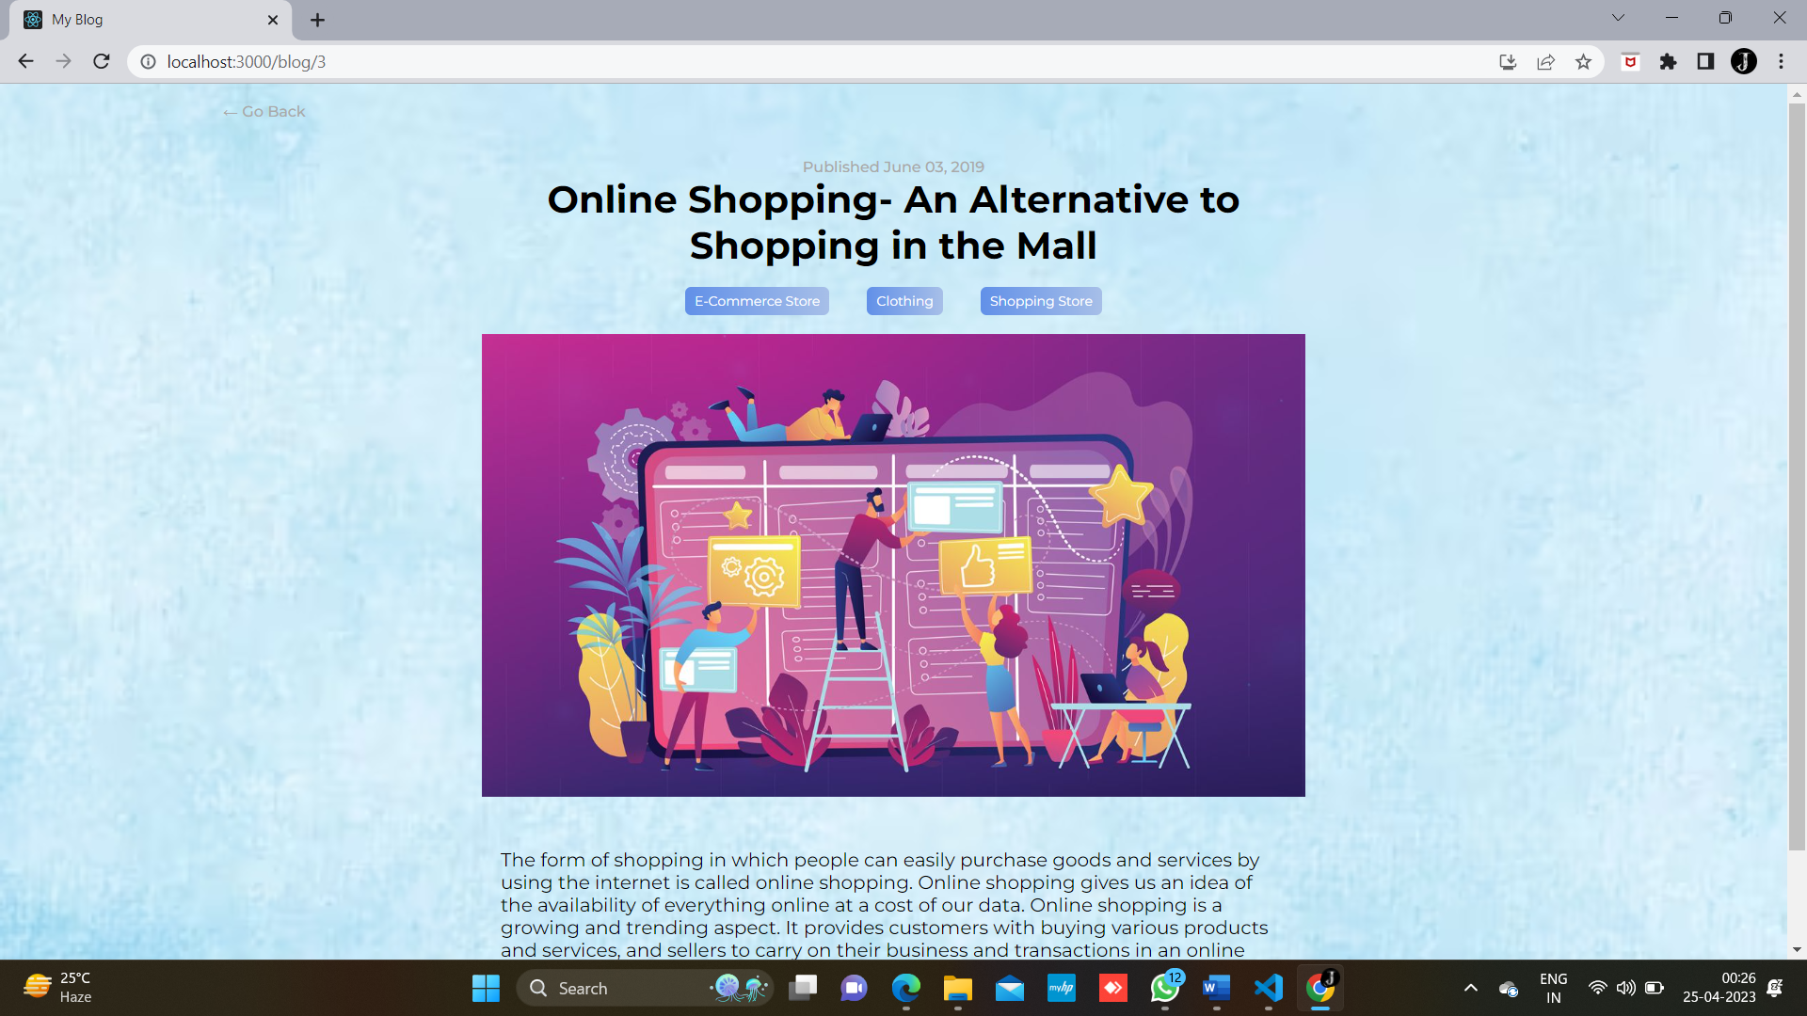
PRODUCTs

Slide 11
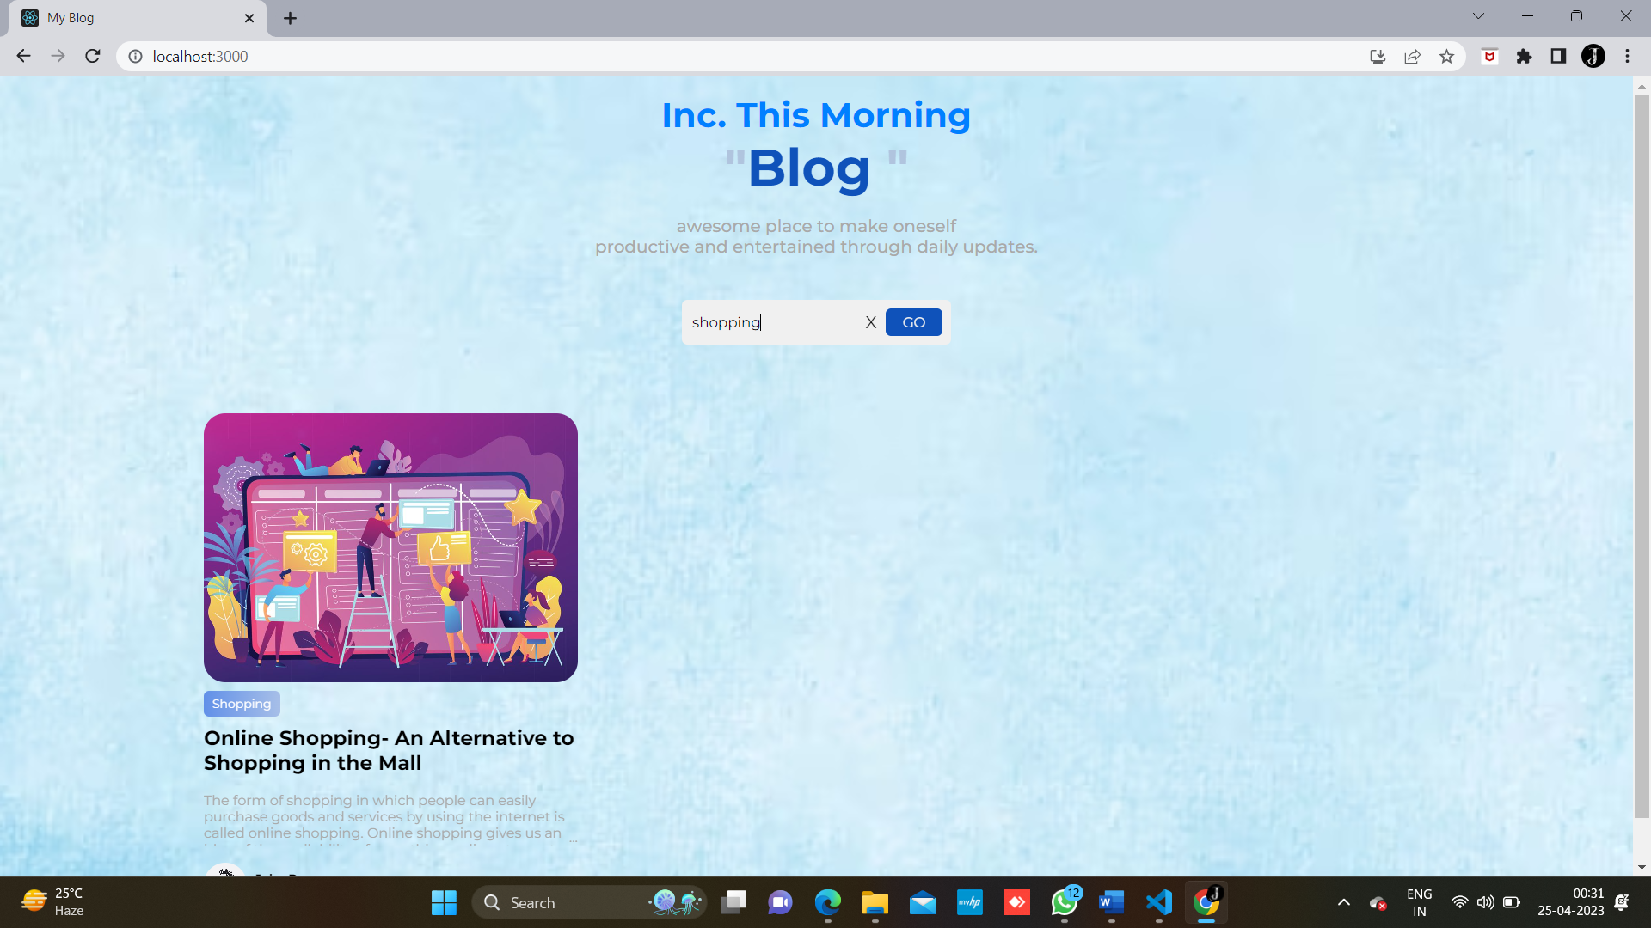
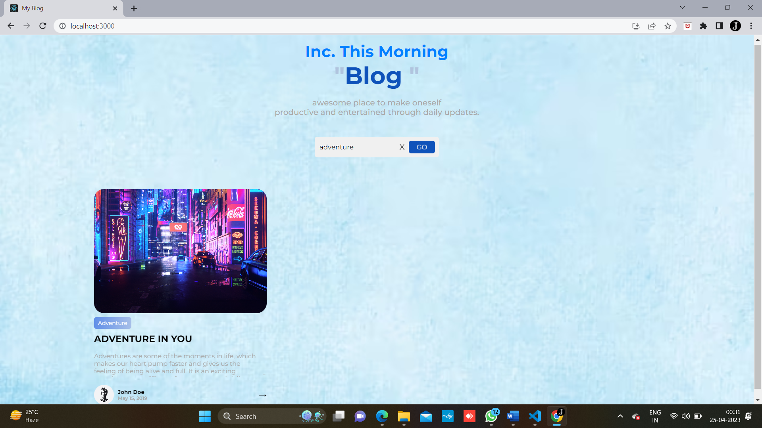
IF the user searched the blog of his interest:

Slide 12
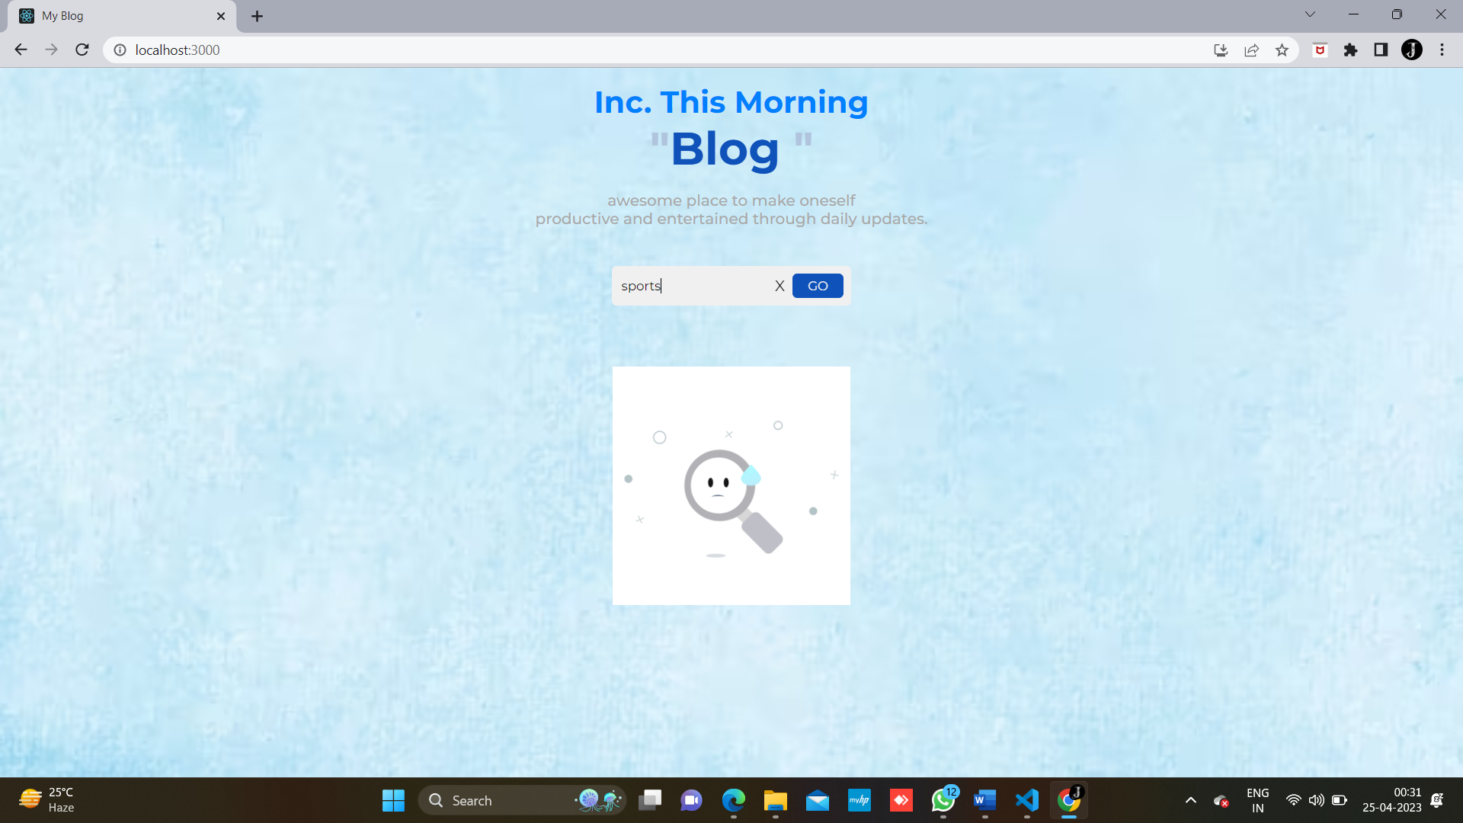
IF the user searched SOMETHING UNWANTED:

Slide 13
Thank you !!

